Slide 1
Design Patterns
CONTENT
introduction
goals
topic
discussion
data
LSV Samarappulige – 20APC4650
examples
conclusion

Slide 2
CONTENT
introduction
Smooth Morph PPT
what is design patterns?
types of design patterns
The quick brown fox jumps over the lazy dog. The quick brown fox jumps over the lazy dog. The quick brown fox jumps over the lazy dog.
creational design patterns
singleton pattern
structural design patterns
INSERT SHORT DESCRIPTION.
façade pattern
behavioral design patterns
observer pattern
resources

Slide 3

CONTENT
introduction
goals
topic
discussion
data
examples
conclusion
what is design patterns?
Design patterns are proven solutions to common software design problems. They represent best practices used by experienced object-oriented software developers.
"Design patterns make it easier to reuse successful designs and architectures."
- Erich Gamma, Richard Helm, Ralph Johnson, John Vlissides (GoF)

Slide 4

introduction
The quick brown fox jumps over the lazy dog. The quick brown fox jumps over the lazy dog. The quick brown fox jumps over the lazy dog.
types of design patterns
Creational Patterns
Structural Patterns
Behavioral Patterns
Creational patterns focus on object creation mechanisms.
Structural patterns deal with object composition and relationships.
Behavioral patterns manage object interactions and responsibilities.
TOPIC TITLE
The quick brown fox jumps over the lazy dog. The quick brown fox jumps over the lazy dog. The quick brown fox jumps over the lazy dog.

Slide 5
Chart Title Here
The quick brown fox jumps over the lazy dog. The quick brown fox jumps over the lazy dog.
Singleton Pattern
Prototype Pattern
creational patterns
examples
Factory Method Pattern
focus on object creation mechanisms.
Builder Pattern

Slide 6
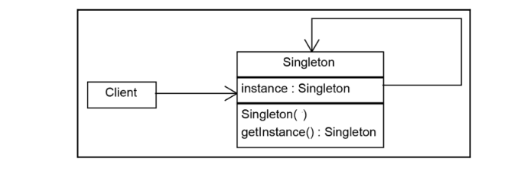



01
02
03
The quick brown fox jumps over the lazy dog. The quick brown fox jumps over the lazy dog.
The quick brown fox jumps over the lazy dog. The quick brown fox jumps over the lazy dog.
The quick brown fox jumps over the lazy dog. The quick brown fox jumps over the lazy dog.
singleton pattern
The Singleton method or Singleton Design pattern is one of the simplest design patterns. It ensures a class only has one instance, and provides a global point of access to it.
Ex :
A configuration in a app
Settings in a website
The quick brown fox jumps over the lazy dog. The quick brown fox jumps over the lazy dog.
The quick brown fox jumps over the lazy dog. The quick brown fox jumps over the lazy dog.
The quick brown fox jumps over the lazy dog. The quick brown fox jumps over the lazy dog.

Slide 7
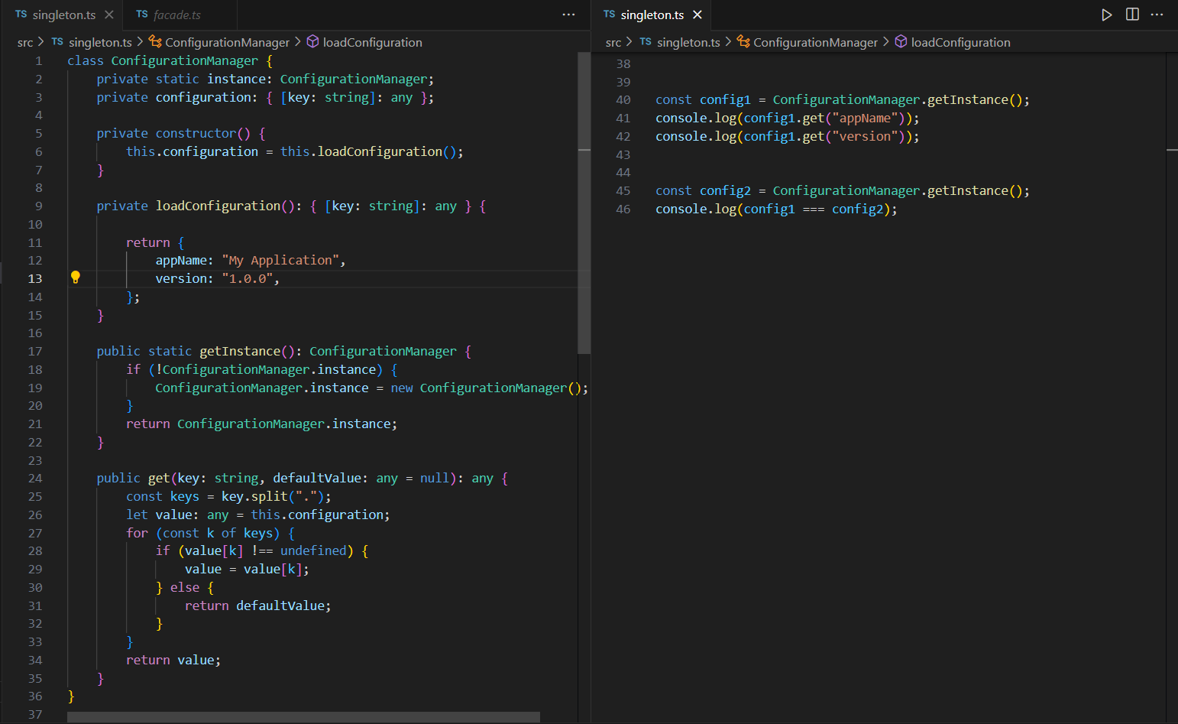

Slide 8
introduction
The quick brown fox jumps over the lazy dog. The quick brown fox jumps over the lazy dog. The quick brown fox jumps over the lazy dog.
types of design patterns
Creational Patterns
Structural Patterns
Behavioral Patterns
Creational patterns focus on object creation mechanisms.
Structural patterns deal with object composition and relationships.
Behavioral patterns manage object interactions and responsibilities.
TOPIC TITLE
The quick brown fox jumps over the lazy dog. The quick brown fox jumps over the lazy dog. The quick brown fox jumps over the lazy dog.

Slide 9
Chart Title Here
The quick brown fox jumps over the lazy dog. The quick brown fox jumps over the lazy dog.
Facade Pattern
Bridge Pattern
structural patterns
examples
Decorator Pattern
deal with object composition and relationships.
Composite Pattern

Slide 10
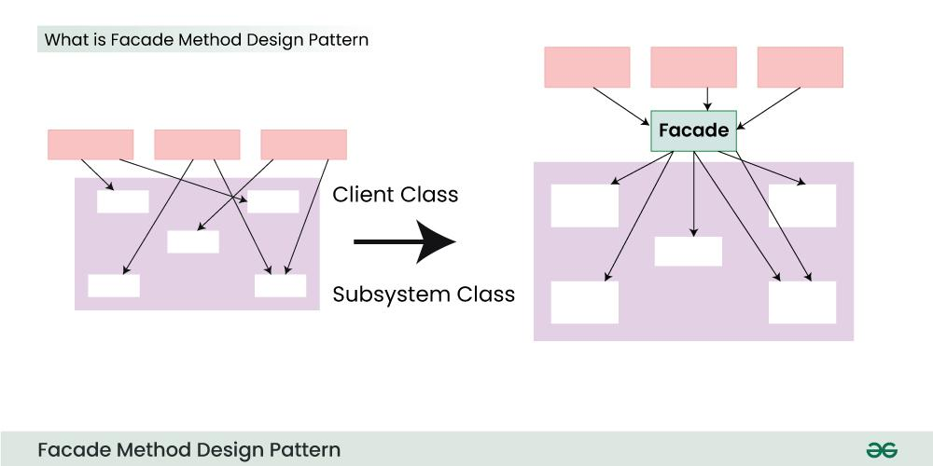
01
02
03
The quick brown fox jumps over the lazy dog. The quick brown fox jumps over the lazy dog.
The quick brown fox jumps over the lazy dog. The quick brown fox jumps over the lazy dog.
The quick brown fox jumps over the lazy dog. The quick brown fox jumps over the lazy dog.
façade pattern
Facade Method Design Pattern provides a unified interface to a set of interfaces in a subsystem. Facade defines a high-level interface that makes the subsystem easier to use.
Ex:
Compiler
Home Theater System
The quick brown fox jumps over the lazy dog. The quick brown fox jumps over the lazy dog.
The quick brown fox jumps over the lazy dog. The quick brown fox jumps over the lazy dog.
The quick brown fox jumps over the lazy dog. The quick brown fox jumps over the lazy dog.

Slide 11
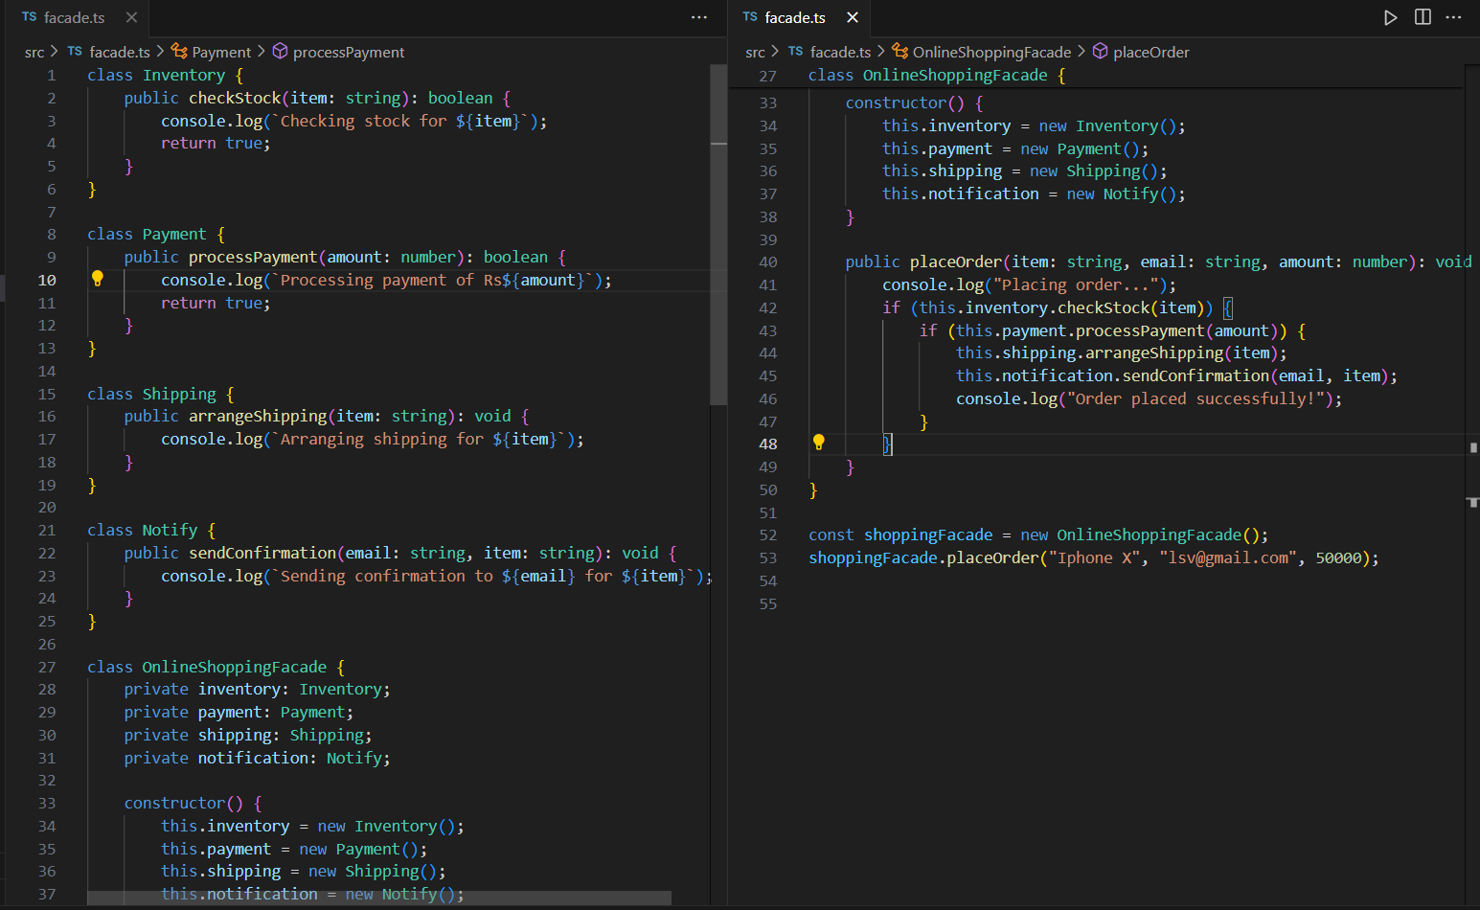

Slide 12
introduction
The quick brown fox jumps over the lazy dog. The quick brown fox jumps over the lazy dog. The quick brown fox jumps over the lazy dog.
types of design patterns
Creational Patterns
Structural Patterns
Behavioral Patterns
Creational patterns focus on object creation mechanisms.
Structural patterns deal with object composition and relationships.
Behavioral patterns manage object interactions and responsibilities.
TOPIC TITLE
The quick brown fox jumps over the lazy dog. The quick brown fox jumps over the lazy dog. The quick brown fox jumps over the lazy dog.

Slide 13
Chart Title Here
The quick brown fox jumps over the lazy dog. The quick brown fox jumps over the lazy dog.
Observer Pattern (PubSub)
Strategy Pattern
behavioral patterns
examples
Memento Pattern
manage object interactions and responsibilities.
Interpreter Pattern

Slide 14
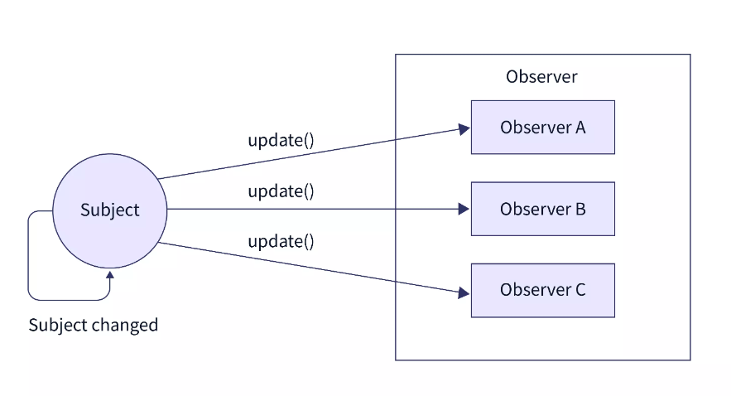
01
02
03
The quick brown fox jumps over the lazy dog. The quick brown fox jumps over the lazy dog.
The quick brown fox jumps over the lazy dog. The quick brown fox jumps over the lazy dog.
The quick brown fox jumps over the lazy dog. The quick brown fox jumps over the lazy dog.
Observer Pattern (PubSub)
This primarily deals with the interaction and communication between objects, specifically focusing on how objects behave in response to changes in the state of other objects.
Ex:
Broadcasting news
The quick brown fox jumps over the lazy dog. The quick brown fox jumps over the lazy dog.
The quick brown fox jumps over the lazy dog. The quick brown fox jumps over the lazy dog.
The quick brown fox jumps over the lazy dog. The quick brown fox jumps over the lazy dog.

Slide 15
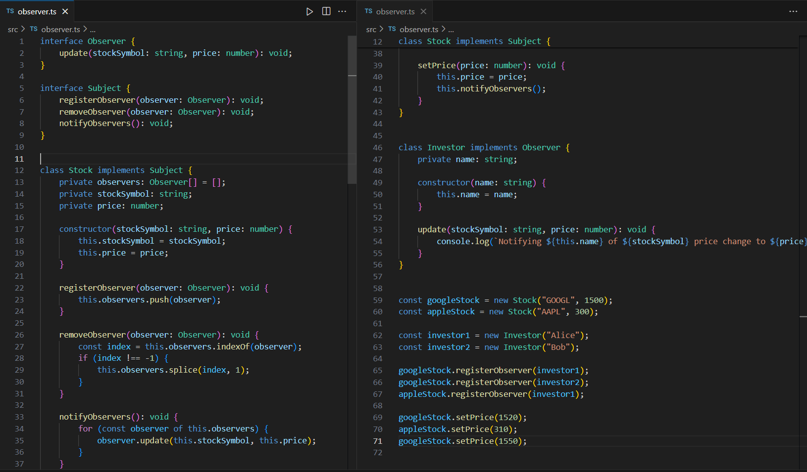

Slide 16
resources
Design patterns make it easier to reuse successful designs and architectures. - Erich Gamma, Richard Helm, Ralph Johnson, John Vlissides
https://www.geeksforgeeks.org/software-design-patterns/
https://www.youtube.com/watch?v=FLmBqI3IKMA
https://www.youtube.com/watch?v=NU_1StN5Tkk
https://www.youtube.com/watch?v=tv-_1er1mWI
https://www.youtube.com/watch?v=FLmBqI3IKMA
https://www.youtube.com/watch?v=KQdiA2HtOxU&list=PLzvRQMJ9HDiSk1pnrKewLklYfCdu9Qjhy&index=5
Insert you first example here.
Thank you!
Insert you second example here.
Insert you third example here.
Insert you fourth example here.

Slide 17

CONCLUSION
The quick brown fox jumps over the lazy dog. The quick brown fox jumps over the lazy dog. The quick brown fox jumps over the lazy dog. The quick brown fox jumps over the lazy dog.
Thank you!
LSV Samarappulige
20APC4650

